Slide 1
Software Engineering and Architecture
Interface Segregation Principle
Role and Private Interfaces

Slide 2
ISP
“Students should not use my Father interface”…
Or ‘do not depend on methods you do not use’
Example:

Slide 3
Fine-grained Roles
The ‘more specific’ role is expressed as a Role Interface
Ala again
I provide a ‘teacher’ interface (one role interface)
And a ‘taxpayer’ interface (another role interface)
Etc.
Martin Fowler

Slide 4
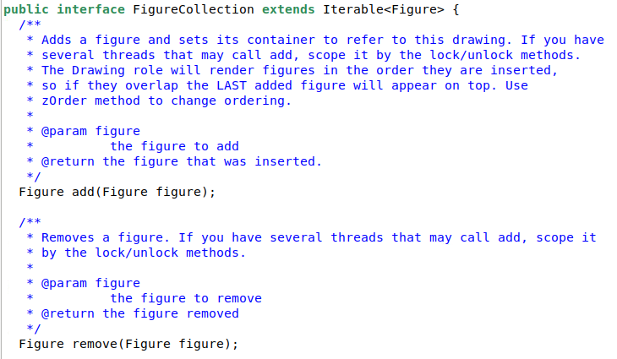
Example
The FigureCollection in MiniDraw only deals with adding, removing, and iterating the collection of Figures in MiniDraw
A specific interaction (add+remove) between the UI and the Drawing, expressed as the Role Interface ‘FigureCollection’

Slide 5
Private Interface
Role interfaces are often used to enforce more specific encapsulation than is possible using private/public methods and instance variables…
Let us make an example, highly inspired by our project…
James Newkirk

Slide 6
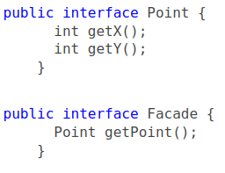
Example
We have a system/framework/Façade which presents (x,y) points to outside code, but that out side code must never modify the (x,y) values!
Read-only Role interface is a solution to that.
Only accessor methods, no mutator methods…

Slide 7
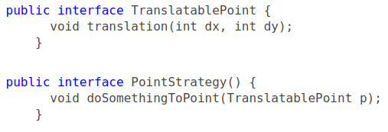
Example
However, internal classes inside the Façade of course needs to mutate the state of these (x,y) points.
Let us say that one class needs to translate (dx,dy) points
Private Interface is a solution to that

Slide 8
Example
Now the internal, implementing, class of course implements both
That is, if you use ‘getPoint()’ from the outside you only get access to ‘getX()’ and ‘getY()’

Slide 9
Example
Now, an internal PointStrategy can translate points like
And can be called internally like

Slide 10
Example
However, a PointStrategy cannot access (x,y)…
However, of course it is often the case, that we need just that.
Exercise: How do we solve that?

Slide 11
Solution 1:
Fine-grained solution: Missing accessor methods
Just add those methods that are missing
Pro
Can select just the right set of accessors
(here it is both of them, but if read-only had 20, we may just pick the two we need).
Con
Same methods are now present in two interfaces

Slide 12
Ups?
Uhum – how does that work in Java?
StandardPoint must now implement ‘getX()’ twice or???
Exercise: What happens?

Slide 13
Solution 2:
Coarse-grained (Lazy) approach: Extend existing
Just implement both
Pro
Less typing
You can actually Program to an Interface in the façade impl!
Con
You get all methods
TranslatablePoint

Slide 14
Mandatory Note
We have read-only role interfaces for Card and Hero in HotStone.
But Game’s implementation and strategies need to manipulate them…
Use private interfaces for that ☺
Strategies needs special mutations of Game
Use private interface(s) for that ☺
Now you ‘program to an interface’, and avoid hard coupling to, say, StandardGame etc.

